Slide 1


Turbo – Opportunistic Enhancement for Edge Video Analytics
Yan Lu, Shiqi Jiang, Ting Cao, Yuanchao Shu

Slide 2
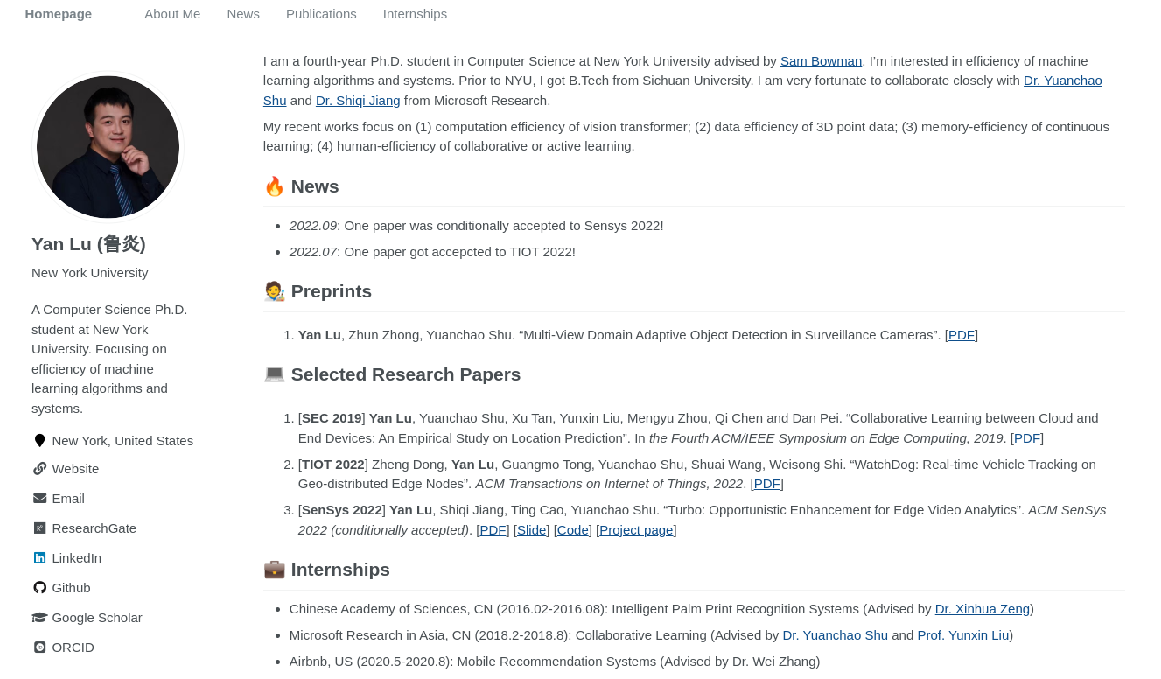

Homepage: https://jason-cs18.github.io/

Slide 3
Contents
Where we are? - edge video analytics
Opportunities for existing VAPs
Idle computing resources
Hard samples
Image (Data) enhancement
Design
Experiments
Summary

Slide 4
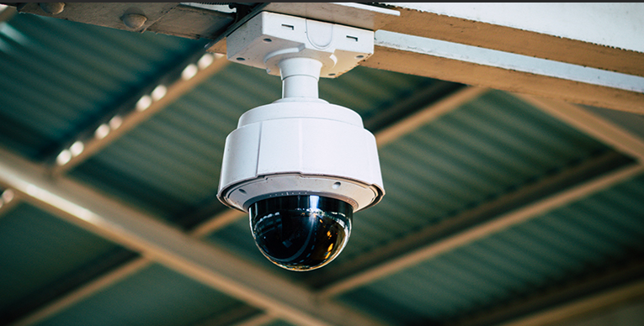
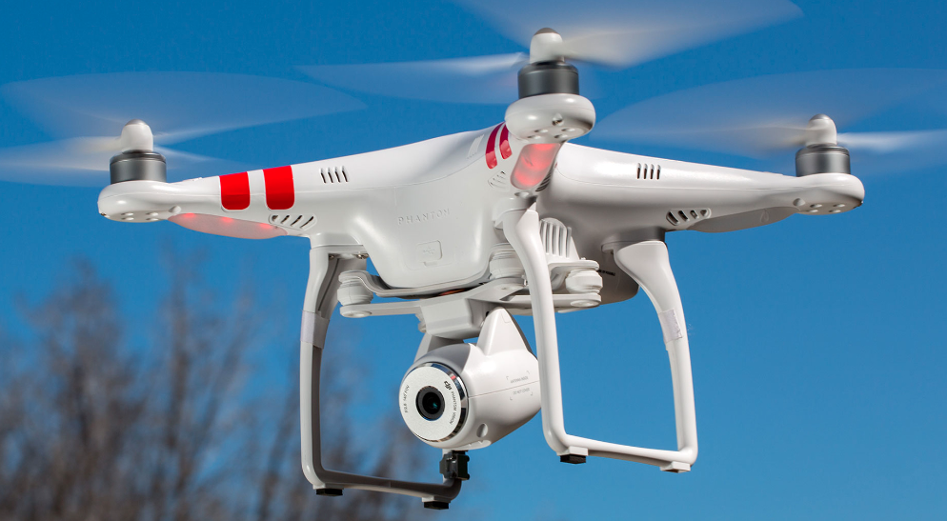
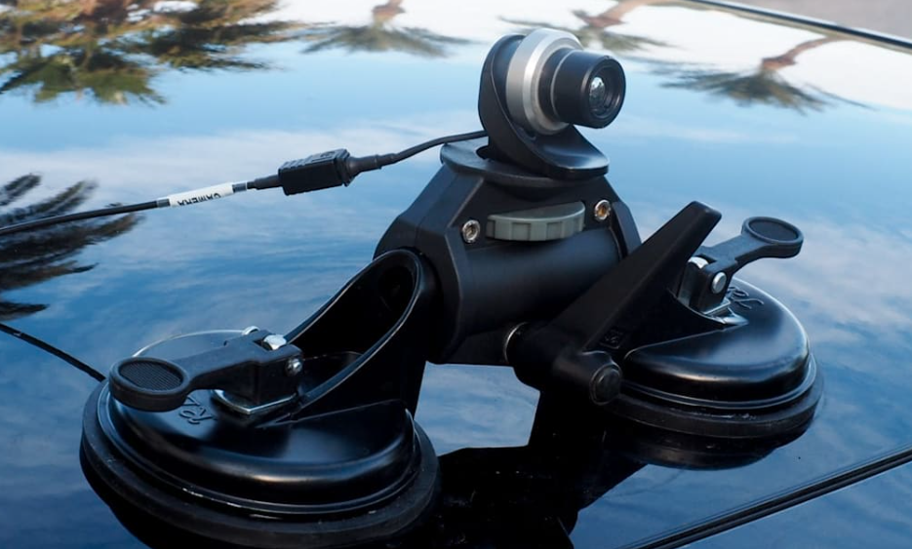
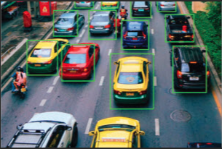
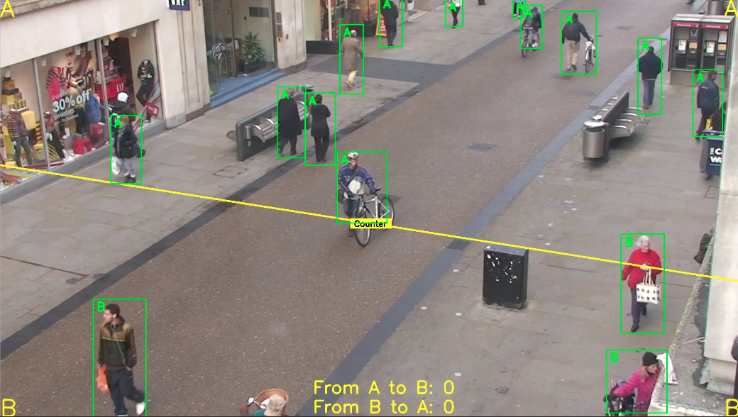
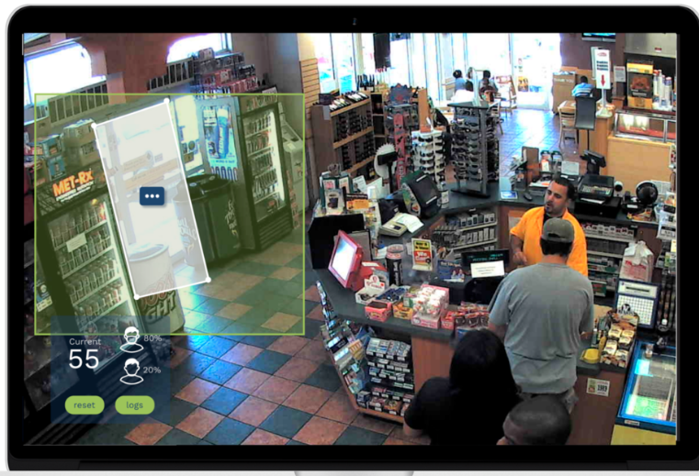
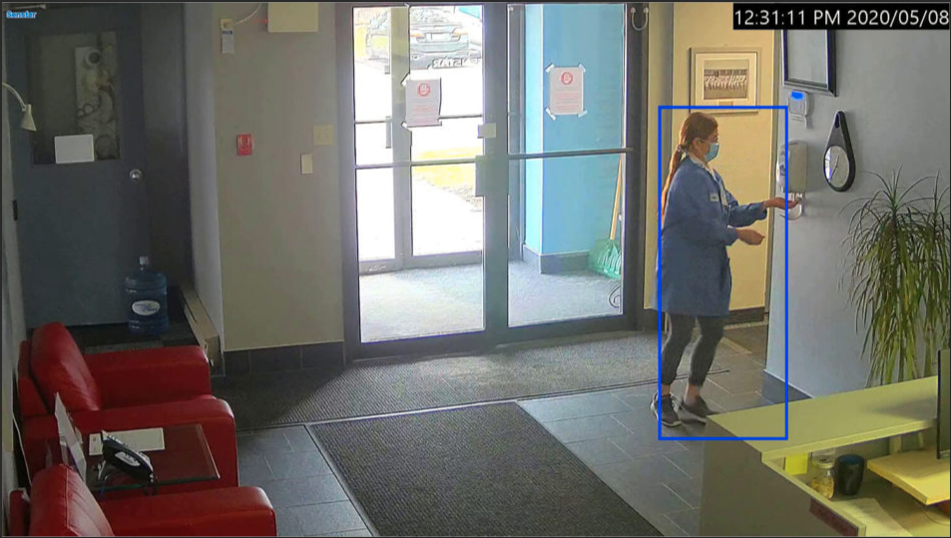
Video is everywhere
Video Analytics

Slide 5
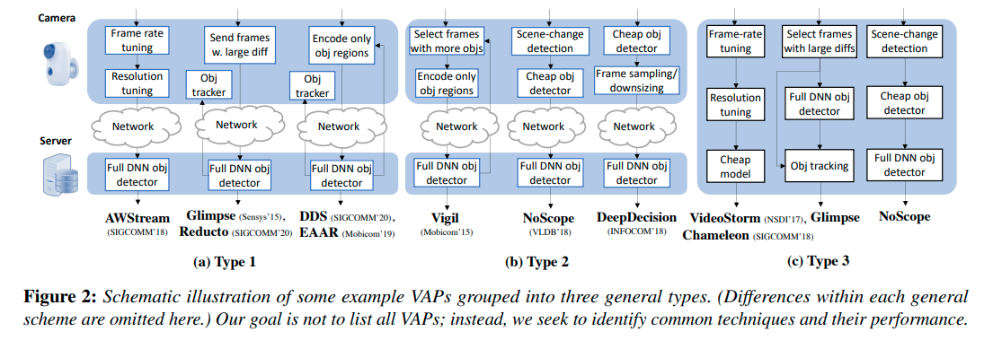
Move to edge
Source: Towards Performance Clarity of Edge Video Analytics. SEC, 2021.
All works balance the trade-off between accuracy and latency via
(1) selecting a smaller model (2) processing less data.

Slide 6
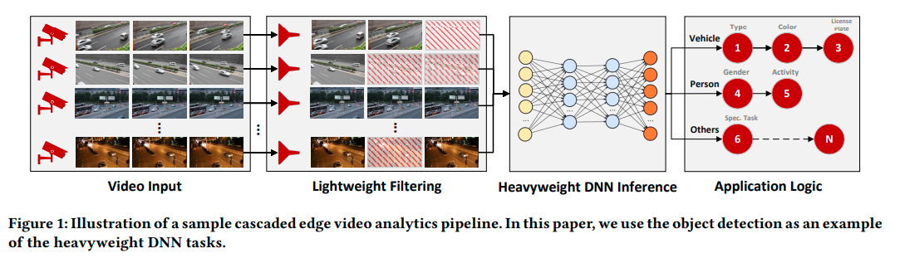
Idle resources are common
Can we leverage these idle resources to improve video analytics?

Slide 7
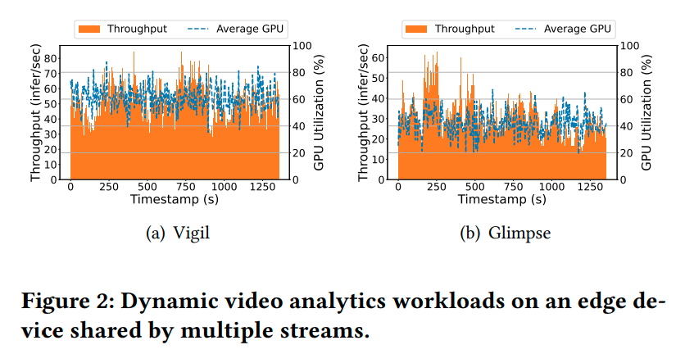
Idle resources are common
It is hard because they are non-deterministic and fragmented!

Slide 8
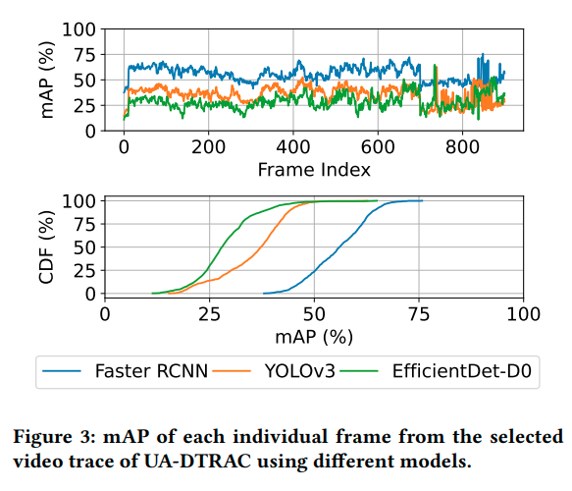
How to leverage idle resources?
A small portion of frames make a bad overall mAP for detectors!
How to improve them? Fine-tuning or changing inputs?
A principal solution?
Y = f (x)
Y = f (g(x))
Y = f (g(x’)) + f(x-x’)
fine
tuning
domain
translation
opportunistic enhancement
hard
cost

Slide 9
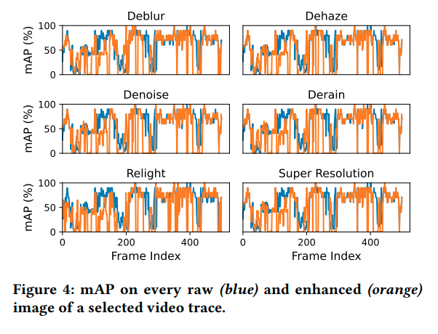
How to improve hard samples?
Image enhancement may help?
It is hard because we must select a suitable enhancement model for hard frames?
Y = f (g(x’)) + f(x-x’)

Slide 10
Key takeaways
Idle computing resources are common but highly dynamic and fragmented.
Overall accuracy of a video analytics task can be boosted significantly when
the quality of a small portion of frames improves.
Running off-the-shelf opportunistic enhancement methods is inappropriate.

Slide 11
How to?
x → D (x) → easy/hard
x’ → G (x) → easy
opportunistic enhancement
x (video)
Y = f (g(x’)) + f(x-x’)
Adversarial Training
How to leverage idle
compute resources to
further improve
overall accuracy?
G(x) enable multi-exit?
Resource-aware scheduler?
T (idle GPU)

Slide 12
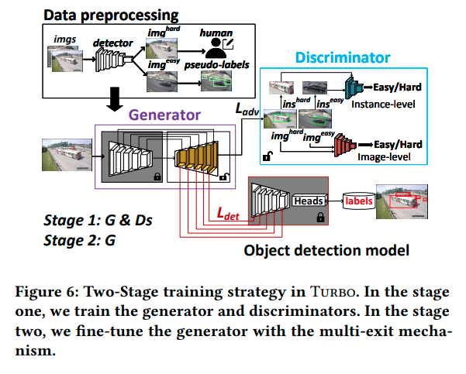
Adversarial training may help?
A generalized enhancement model can be learned in a implicit way.
A discriminator can be used to classify easy and hard samples.

Slide 13
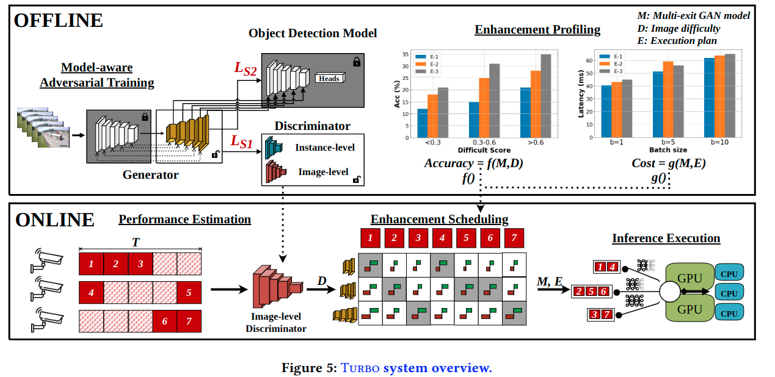
Turbo – An Opportunistic Enhancement

Slide 14
A detector-specific GAN
Stage 1: learning a detector-specific GAN for a specific downstream object detection.
Stage 2: a multi-exit mechanism

Slide 15
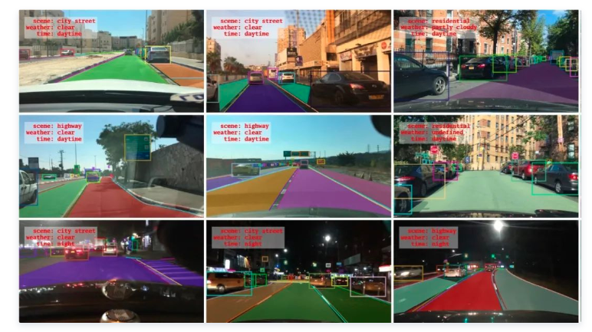
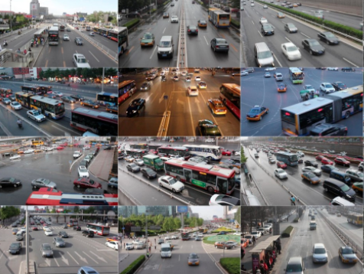
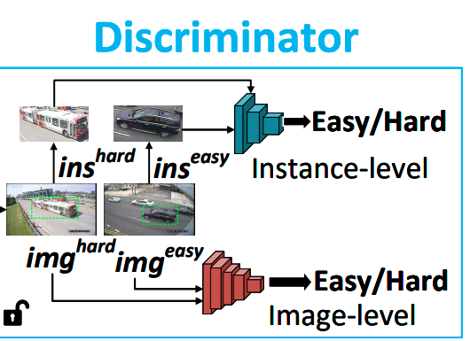
Pre-training and fast adaptation
Pre-training
BDD100K
(100K driving videos)
Unsupervised adaptation
Unlabeled target videos

Slide 16
Resource-aware scheduling

Slide 17
Demo (Coming soon)

Slide 18
Experiments
Detectors: YOLOv3, Faster RCNN, EfficientDet-D0.
Test platforms: Nvidia Tesla V100 and Tesla T4.
Testing Dataset: UA-DETRAC and AICity.
Video analytics pipeline:
Glimpse: temporal pruning
Vigil: model pruning
NoScope: temporal pruning + model pruning

Slide 19
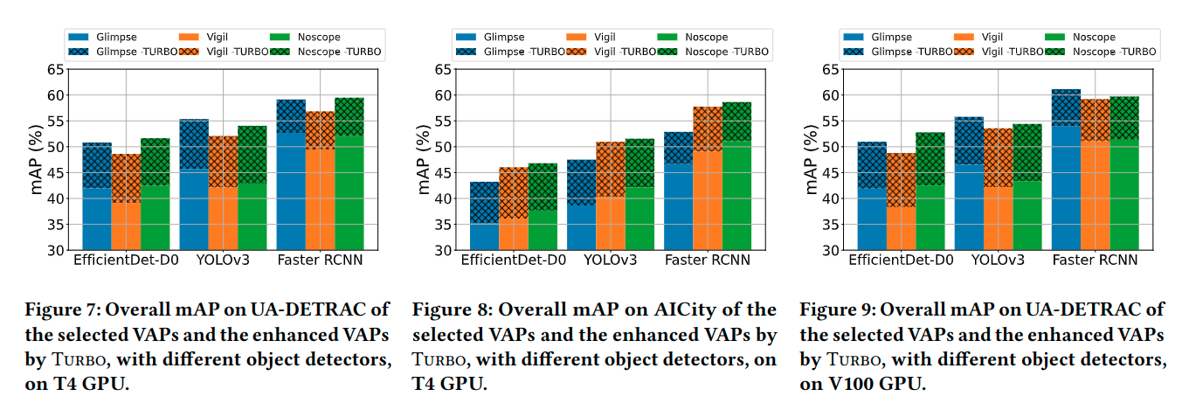
End-to-end results (Accuracy)

Slide 20
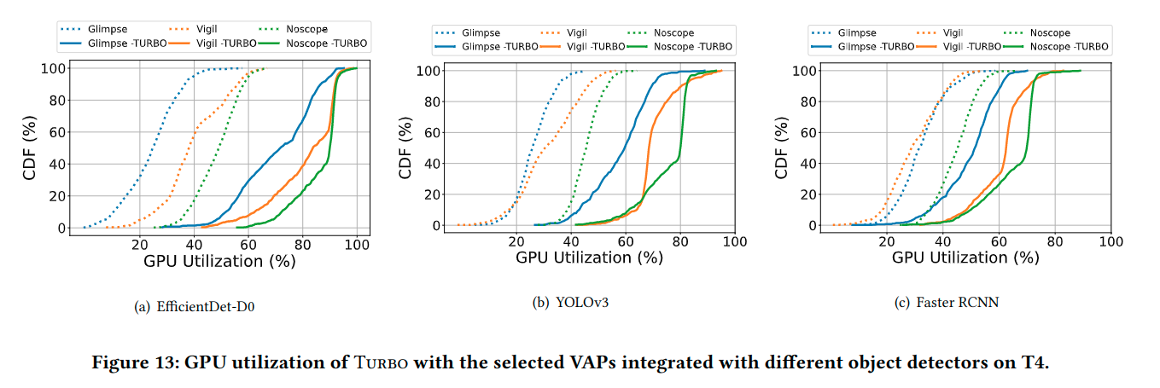
End-to-end results (idle GPU)

Slide 21

Summary
Even on advanced video analytics pipelines, idle computing resources are common but ignored.
Turbo selectively enhances incoming frames based GPU resource availability via a detector-specific GAN and resource-aware scheduling algorithm.
Turbo achieves 7.27-11.34% mAP improvements by judiciously allocating 15.81-37.67% GPU idle resources.
Turbo is released at https://aka.ms/turbo-project (coming soon).

